Slide 1
Required fields

Slide 2
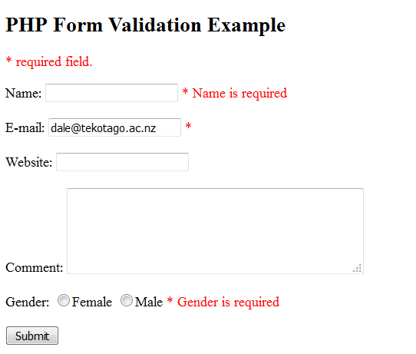
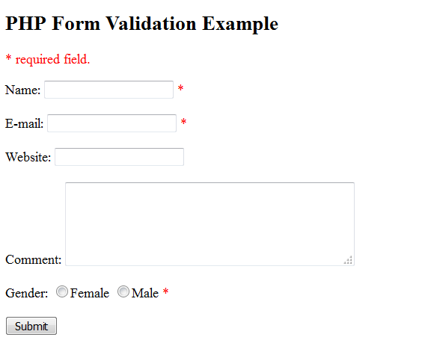
Required fields

Slide 3
Logic
If they are submitting the form
Populate any error messages
Clean the data
If there are error messages
Show the form
Else create the record
Else show the form

Slide 4
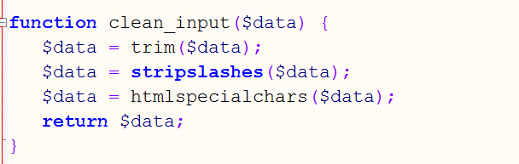
Sanitizing and Validating User Data
When users submit data, you need to make sure that they've provided something you expect.
This function only cleans

Slide 5
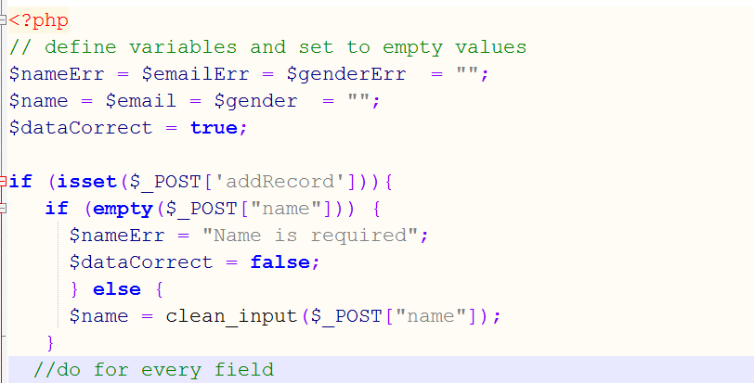
Error variables

Slide 6
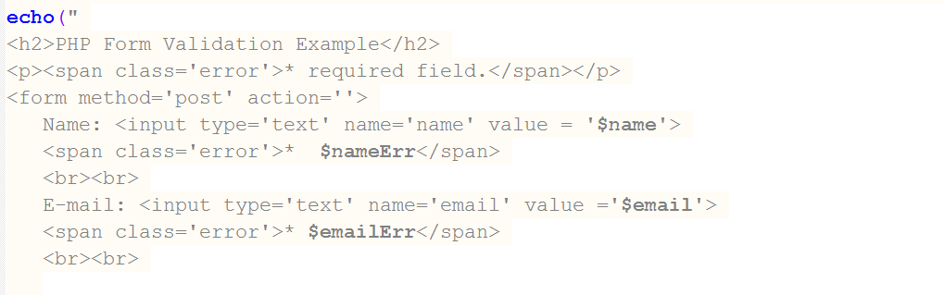
Don’t make me retype good fields

Slide 7
Reading
http://www.w3schools.com/php/php_form_validation.asp

